Slide 1
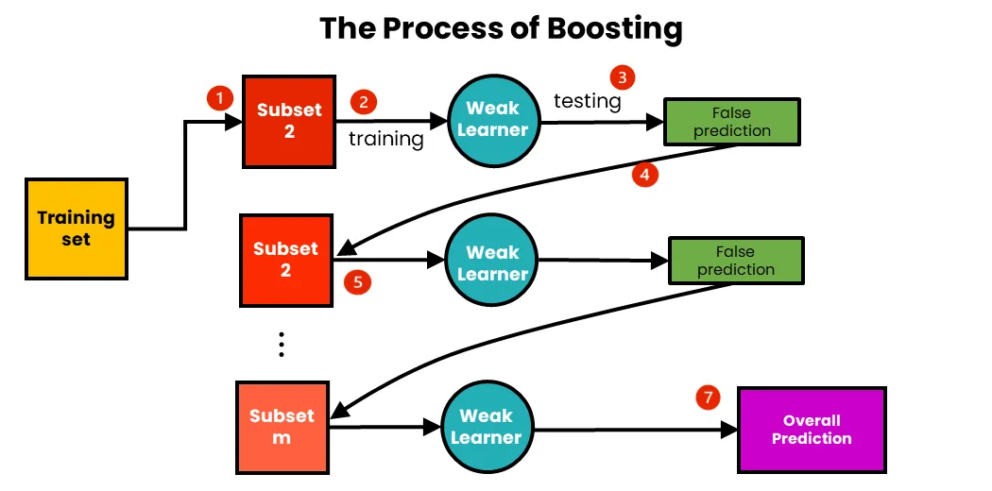
Boosting Algorithm-Regression
A "boosting algorithm for regression" is a machine learning technique that iteratively combines multiple weak prediction models (often decision trees) to create a single, strong predictive model for regression tasks.
where each new model is trained to specifically correct the errors made by the previous models, resulting in a more accurate overall prediction.
Essentially, it builds upon previous predictions by focusing on the residuals (errors) to improve the final result.
Notes:
g

Slide 2
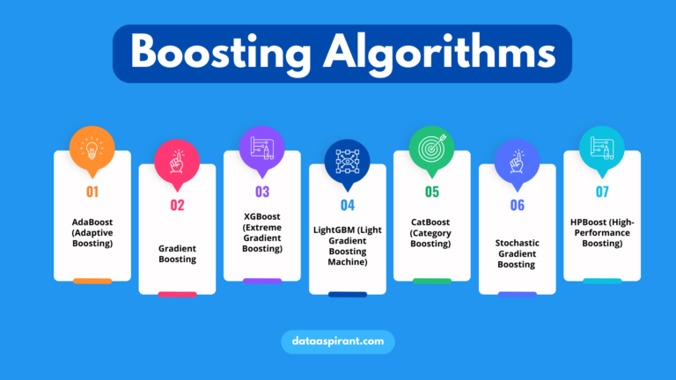
Boosting Algorithm-Types
When it comes to regression tasks, the most common types of boosting algorithms include: Gradient Boosting, AdaBoost, XG Boost (Extreme Gradient Boosting), Cat Boost, and Light GBM (Light Gradient Boosting Machine).
These are used for regression problems by building ensembles of weak prediction models, typically decision trees, to improve overall accuracy

Slide 3
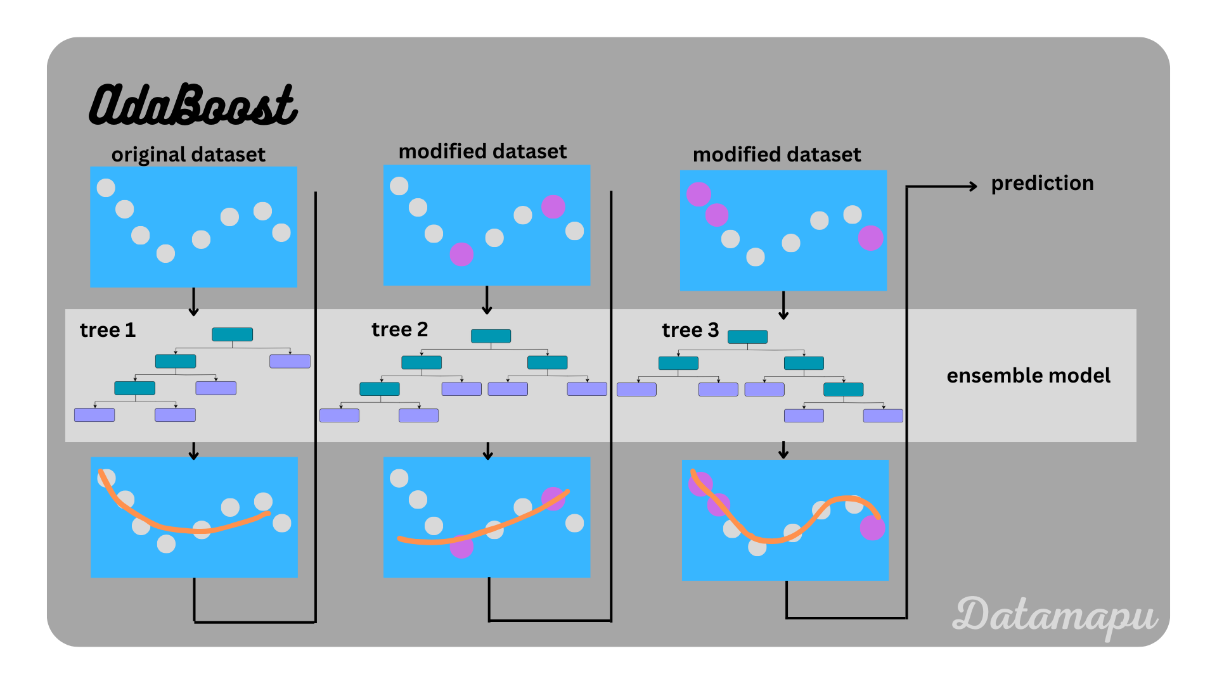
ADA Boosting Algorithm-Regression
The AdaBoost algorithm can be used for regression tasks, meaning it can be applied to predict continuous values, by sequentially building multiple weak learners (often decision trees) and weighting the data points based on their previous prediction errors ultimately combining them to create a strong predictor for the regression problem;
Essentially, it works by focusing more on the data points that were harder to predict in previous iterations, improving the overall accuracy of the regression model.

Slide 4
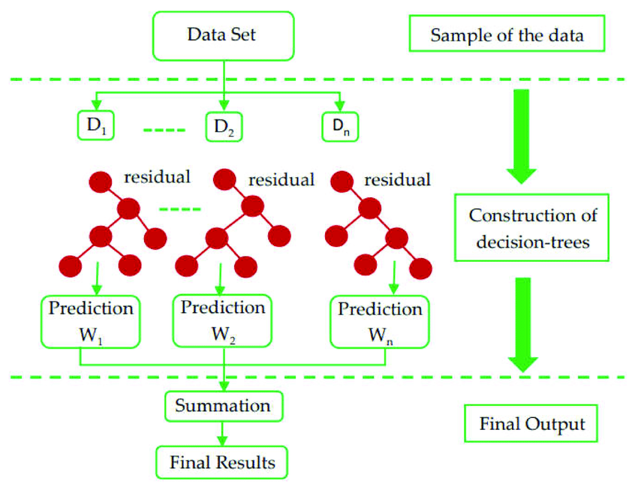
XG Boosting Algorithm-Regression
XG Boost is a gradient boosting decision tree algorithm that can be used for regression.
A generic unregularized XG Boost algorithm involves initializing the model with a constant value, computing the 'gradients' and 'hessians', and fitting a base learner (or weak learner, e.g. tree) using the training set.
This process is repeated for a number of weak learners and a learning rate.
The XG Boost library implements this algorithm

Slide 5
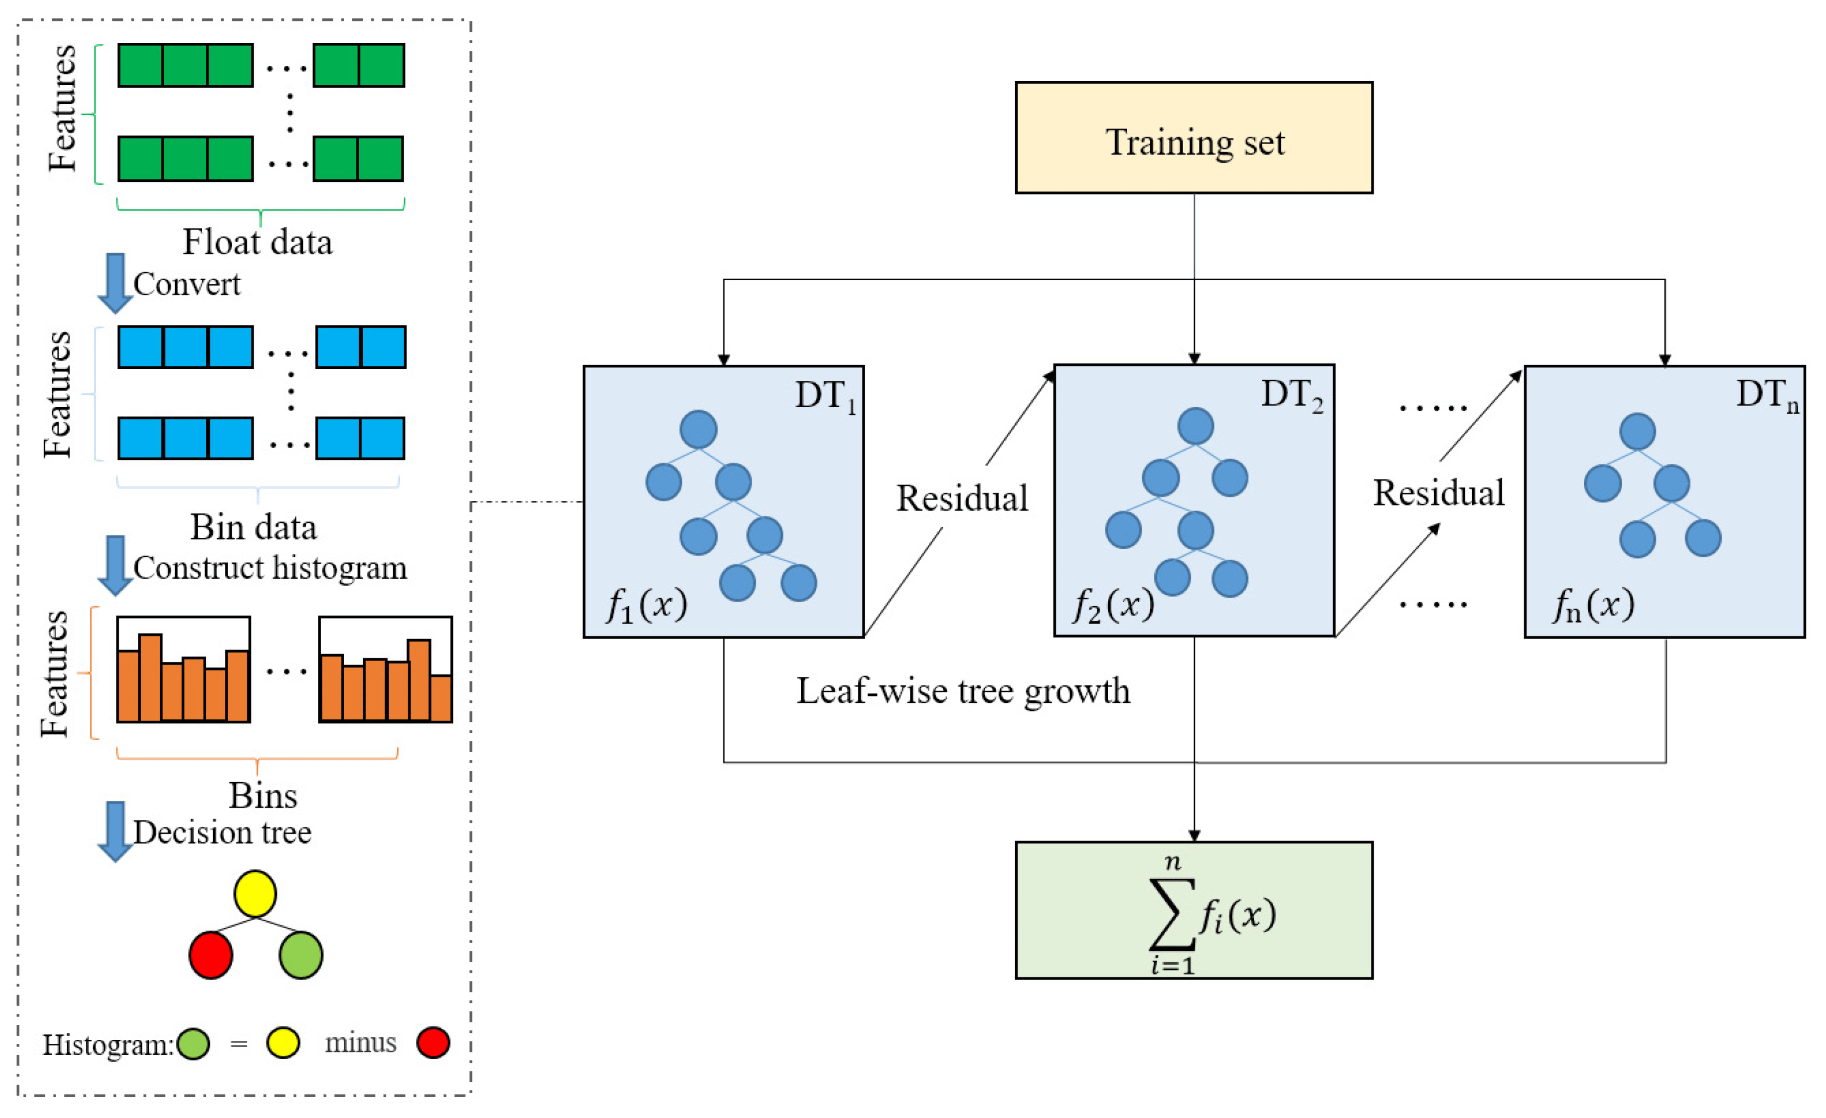
LG Boosting Algorithm-Regression
Light GBM is an implementation of gradient boosting decision trees designed to be distributed and efficient. It is known for its speed and performance, especially with large datasets.
Light GBM grows tree leaf-wise (best-first), which can lead to better accuracy compared to level-wise growth.
It uses a histogram-based algorithm to speed up training and reduce memory usage.
Light GBM can handle categorical features directly, without the need for one-hot encoding. It supports parallel and distributed learning, making it scalable.

Slide 6
Application were Boosting Algorithm can be used -Regression
Ada Boost Algorithm-
Financial Forecasting
Property prices in real estate
Customer lifetime value.
XG Boost Algorithm-
Sales forecasting
Financial performance analysis.
Fraud detection
LG Boost Algorithm-
Sales forecasting
Customer churn prediction
Risk assessment

